Slide 1
Build Deep Neural Network

Slide 2
手動建立2x3x3x1的網路

Slide 3
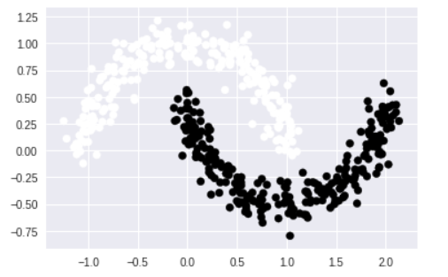
計算Moons資料集

Slide 4
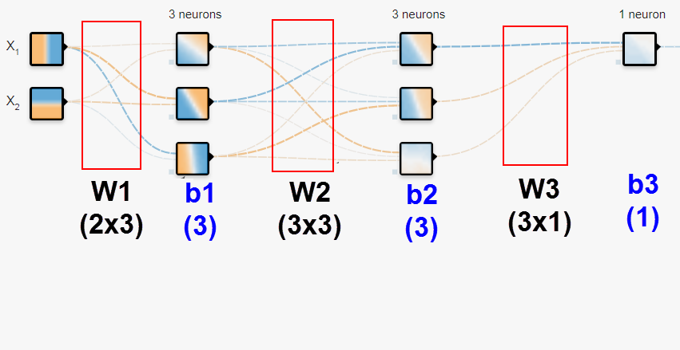
3x3x1的網路
Notes:
loss = (\hat{y}-y)^2 = (x*w-y)^2
\frac{\partial{loss}}{\partial{w}}=?

Slide 5

W值為矩陣(用大寫表示)
Notes:
loss = (\hat{y}-y)^2 = (x*w-y)^2
\frac{\partial{loss}}{\partial{w}}=?

Slide 6
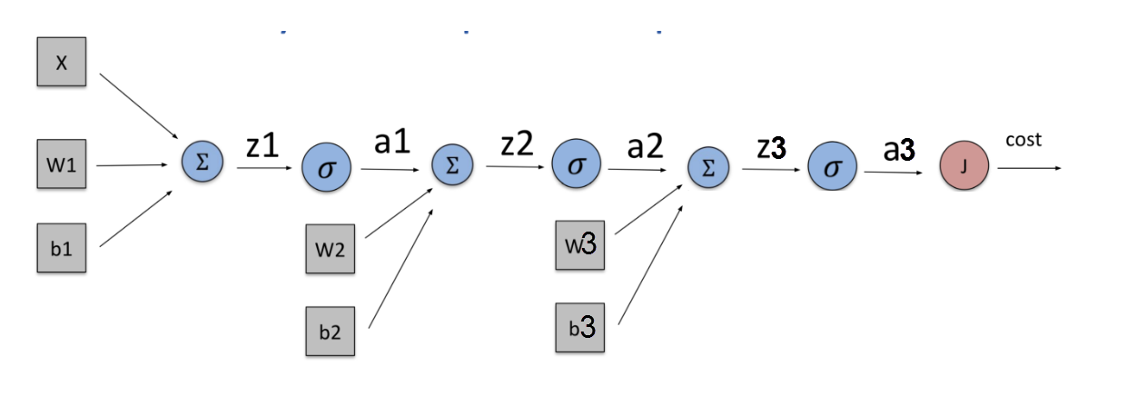
Feedforward Network
z1 = W1*x + b1
a1 = sigmoid(z1)
z2 = W2*x + b2
a2 = sigmoid(z2)
z3 = W3*x + b3
a3 = sigmoid(z3)
Notes:
loss = (\hat{y}-y)^2 = (x*w-y)^2
\frac{\partial{loss}}{\partial{w}}=?

Slide 7
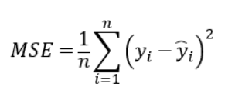
Loss Function
Notes:
loss = (\hat{y}-y)^2 = (x*w-y)^2
\frac{\partial{loss}}{\partial{w}}=?

Slide 8
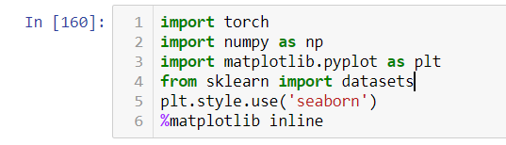
Import libraries

Slide 9
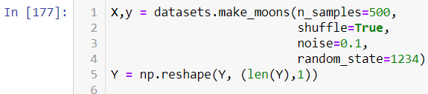
Make samples

Slide 10
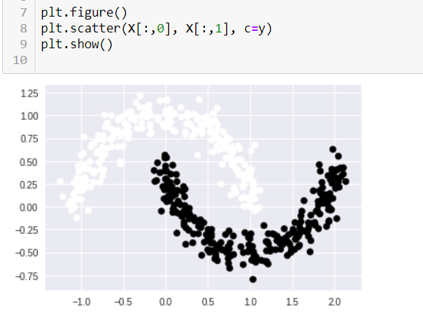
Plot moons datasets

Slide 11
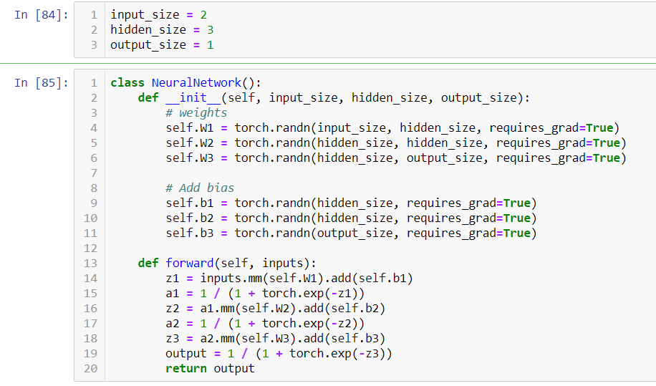
Define model

Slide 12
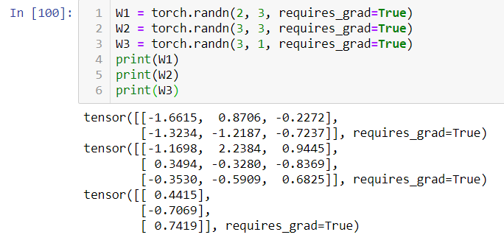
Sizes of weights

Slide 13
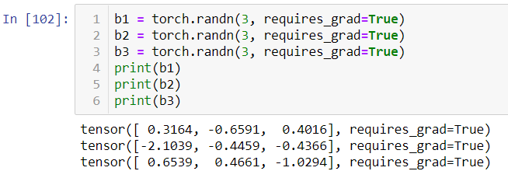
Sizes of biases

Slide 14
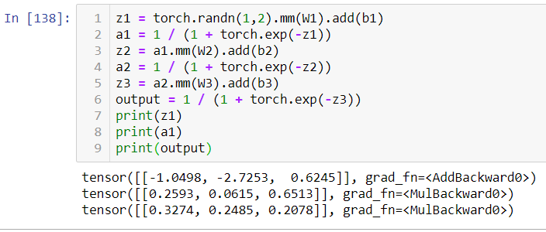
Values of deltas and errors

Slide 15
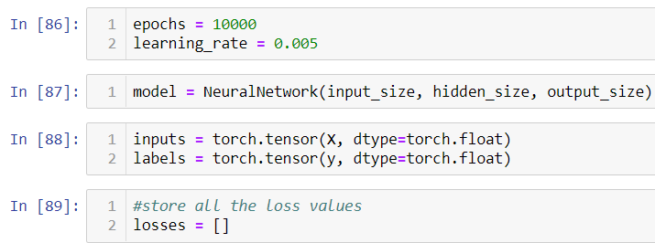
Epoch, lr, mode, input and pred

Slide 16
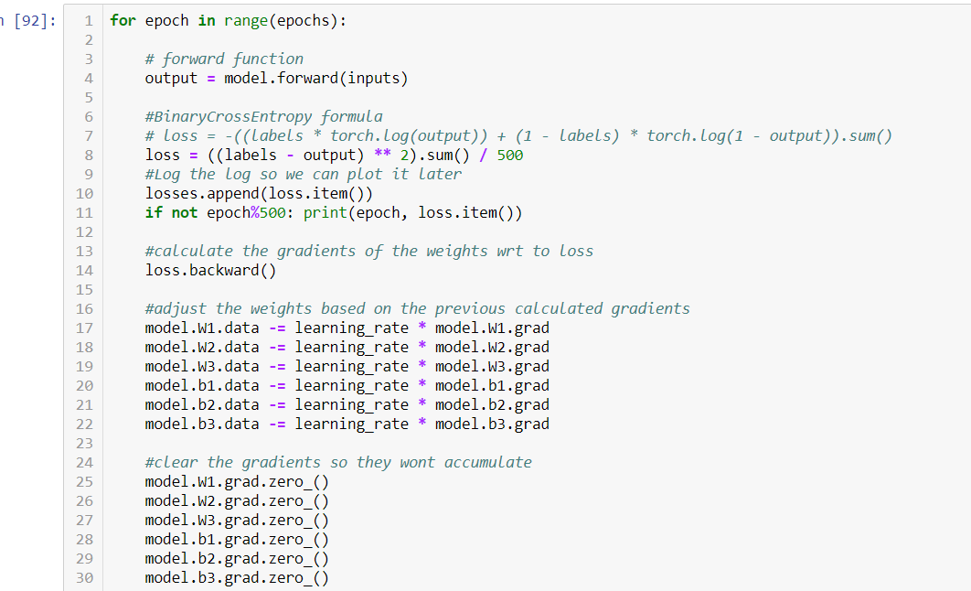
Training

Slide 17

向前傳遞網路

Slide 18

計算loss function的值

Slide 19

反向傳遞更新所有w/b的梯度

Slide 20
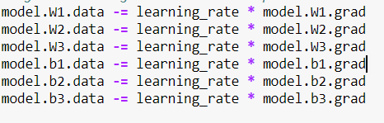
將每一個w/b梯度下降更新值

Slide 21
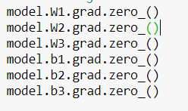
將每一個w/b梯度歸零

Slide 22

跑10000個epoch(1萬輪)

Slide 23
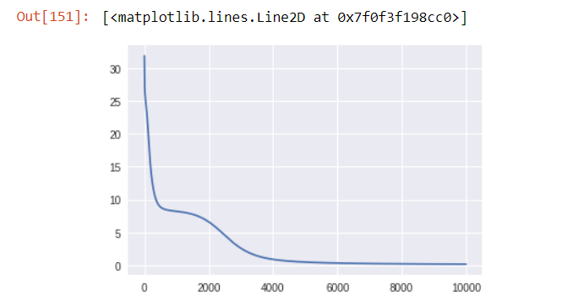
畫出loss值變化圖

Slide 24
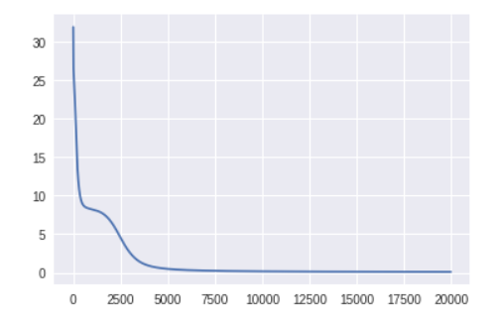
增加epoch(2萬輪)

Slide 25
使用pytorch建立2x3x3x1的網路

Slide 26




PyTorch Rhythm
Design your model using class with Tensors
Construct loss and optimizer
(select from PyTorch API)
Training cycle
(forward, backward, update)

Slide 27
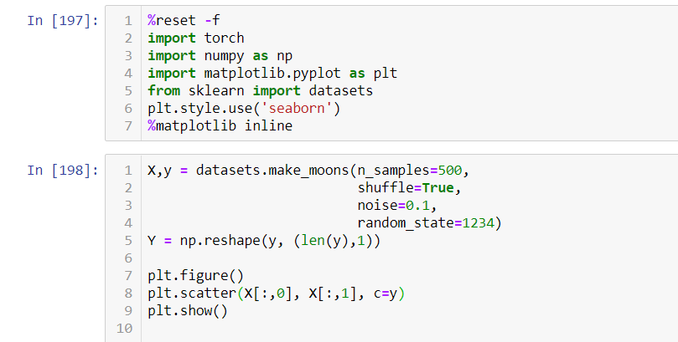
Libraries, samples

Slide 28
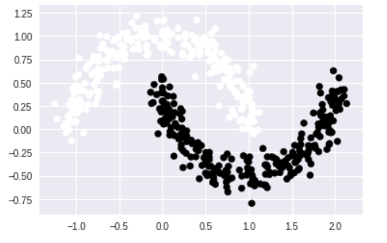
Plot samples

Slide 29
Feedforward Network
z1 = W1*x + b1
a1 = sigmoid(z1)
z2 = W2*x + b2
a2 = sigmoid(z2)
z3 = W3*x + b3
a3 = sigmoid(z3)
Notes:
loss = (\hat{y}-y)^2 = (x*w-y)^2
\frac{\partial{loss}}{\partial{w}}=?

Slide 30
All layers are linear functions
z1 = W1*x + b1
a1 = sigmoid(z1)
z2 = W2*x + b2
a2 = sigmoid(z2)
z3 = W3*x + b3
a3 = sigmoid(z3)
Notes:
loss = (\hat{y}-y)^2 = (x*w-y)^2
\frac{\partial{loss}}{\partial{w}}=?

Slide 31
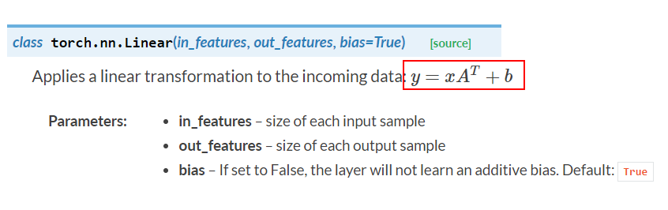
Use PyTorch’s Linear Module

Slide 32
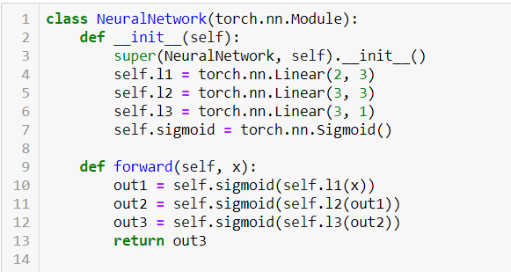
Define model

Slide 33
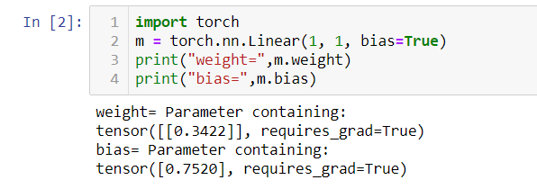
Pytorch Linear Module
y = wx + b (一進(x)，一出(y))

Slide 34
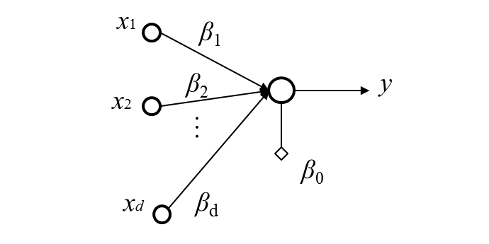
Multi-dimension linear regression

Slide 35
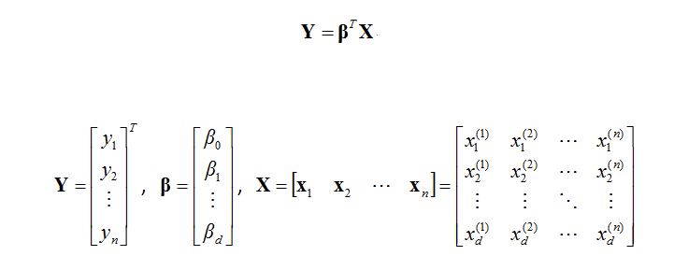
Calculate Bias and Weight
Notes:
loss = (\hat{y}-y)^2 = (x*w-y)^2

Slide 36
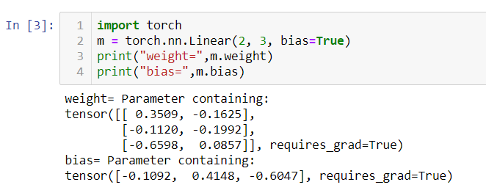
Pytorch Linear Module
Y = WX + B (二進(x)，三出(y))

Slide 37
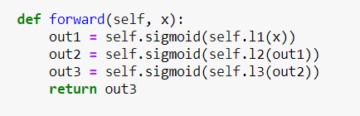
Feedforward network

Slide 38
PyTorch Way
不需要自行定義w，b，都被定義在函數中
不需要自行計算error，delta值，都定義在函數中
不需要管陣列中的單獨值，所有的w，b都以tensor的方式表示，會自動計算
只要用backward算出梯度，即會自動計算每一個tensor中的每一個w/b純量值

Slide 39
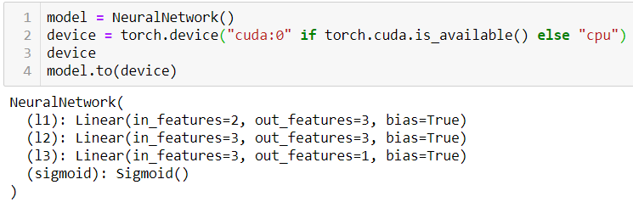
定義網路並放入GPU

Slide 40

把輸入值放入GPU

Slide 41

定義LOSS FUNCTION及最佳化方法

Slide 42
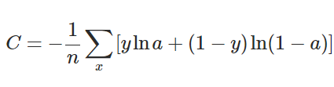
Cross Entropy

Slide 43
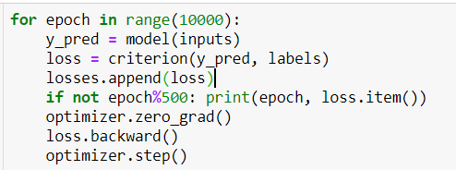
Training

Slide 44
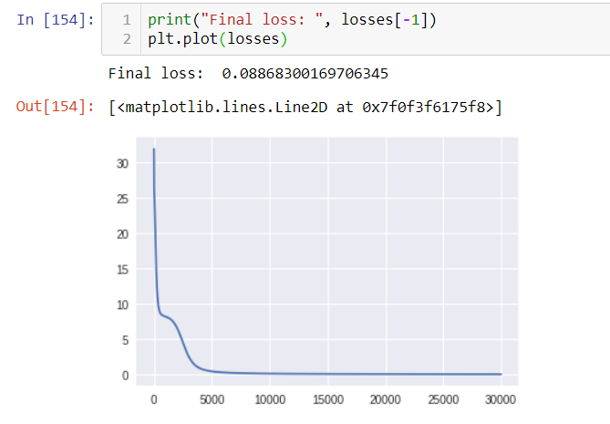
Plot loss

Slide 45
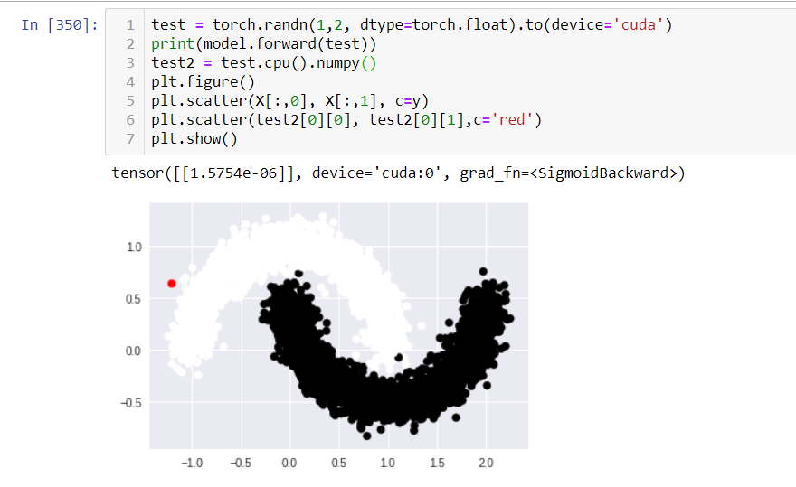
Test new point

Slide 46
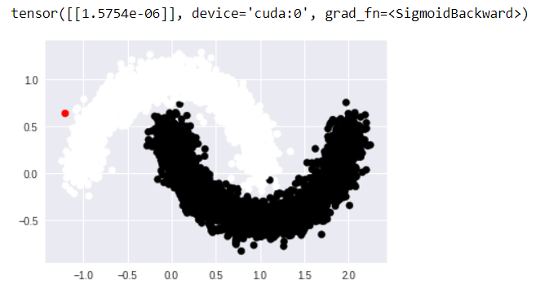
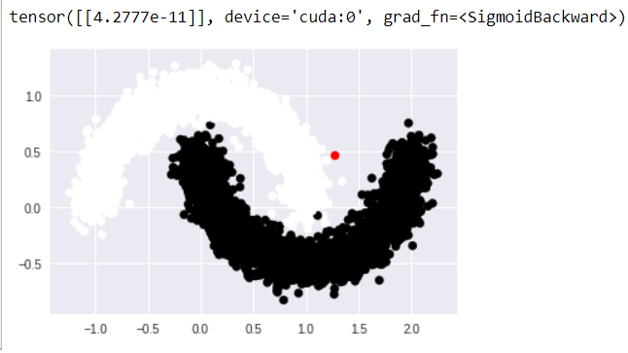
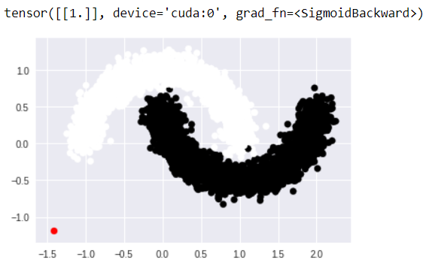
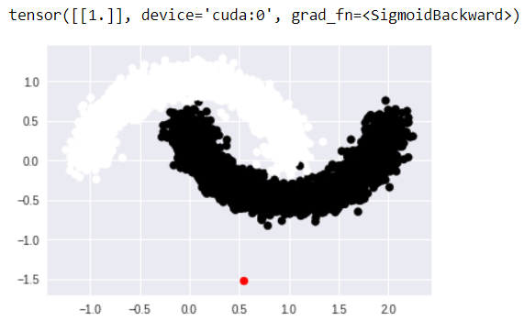
Test new points

